Slide 1
Employee Data Analysis using Excel
STUDENT NAME:REVANTH KKUMAR.P
REGISTER NO:122203034
DEPARTMENT:B.COM.(CS)
COLLEGE: Chennai National College of Arts and Science ,Avadi -54.

Slide 2
PROJECT TITLE
Employee Attendance Analysis using Excel

Slide 4

PROBLEM STATEMENT
Traditional attendance monitoring system can be time consuming and can lead to impersonation and misplacement of attendance sheets.

Slide 5

PROJECT OVERVIEW
The attendance management system keeps track of daily attendance , working hours , breaks , login , logout time.
It prevents staff time theft.
An attendance management system integrates all attendance devices such as smart cards , biometrics , and facial recognition devices in real time.

Slide 6


AGENDA
Problem Statement
Project Overview
End Users
Our Solution and Proposition
Dataset Description
Modelling Approach
Results and Discussion
Conclusion
3/21/2024 Annual Review

Slide 7
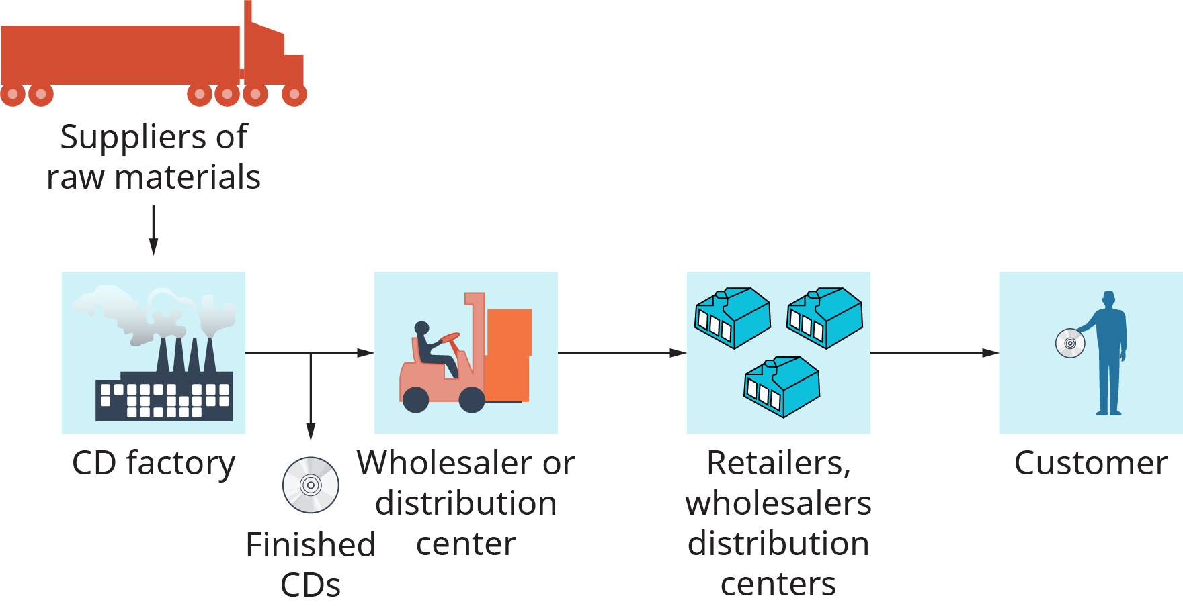

WHO ARE THE END USERS?

Slide 8

OUR SOLUTION AND ITS VALUE PROPOSITION
conditional formatting.
Pivot chart
Formula for calculating
Design

Slide 9
Dataset Description
the data refers to details on the total number of days each member signed the members attendance register in the sessions.

Slide 10

THE "WOW" IN OUR SOLUTION
I have used a different formulas for the calculation of sum and total. And also used the conditional formatting to point the salary levels in detail.
3/21/2024 Annual Review
10

Slide 11
MODELLING
1.Conditional formatting:
In excel the conditional formatting was used for figure the salary on the basis of below and low amount.
2. Pivot chart:
The pivot chart has used for the diagrammatic form of the employees attendance analysis. Also it was easy to understand the chart easily.
3.Row and columns:
In the row and columns was mentioned by the names of the employees and their total working days and the days they have been worked and the provided salary based on their working days.
4. formula:
In the analysis the different formula are used to calculate the salary and the working days easily . This is helpful for time saving.
11

Slide 12
RESULTS
12

Slide 13
conclusion
Regular attendance is important for employee productivity and the success of the organization .
It can help ensure that tasks are completed on time and that projects are finishes on schedule .

